Slide 1
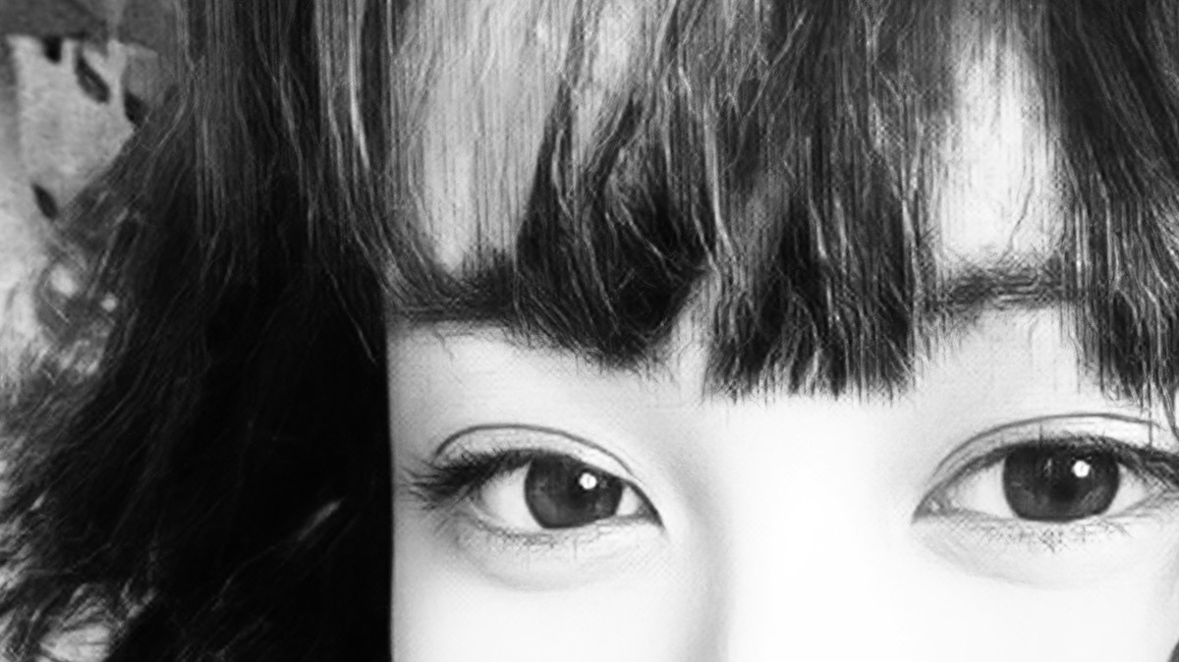
CASSANDRA
DELA CRUZ
VIDEO EDITOR/PHOTOGRAPHER
WORK WITH ME

Slide 2
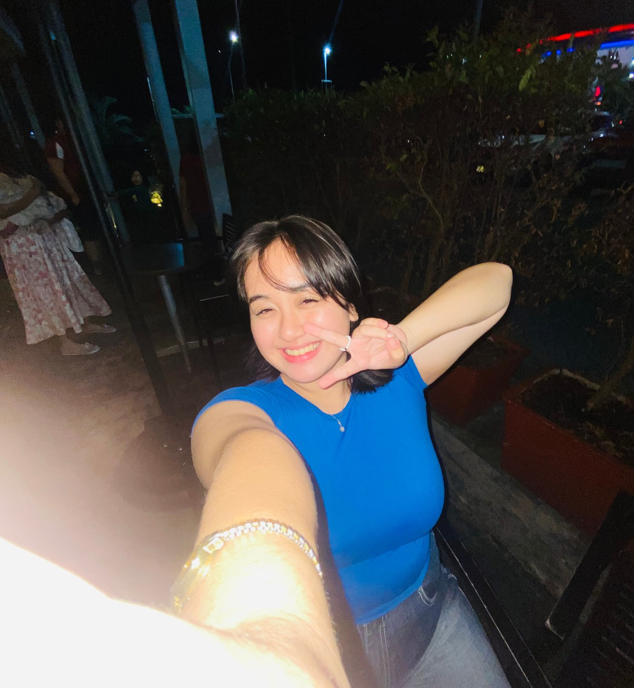
Hi, my name is
CASSANDRA
Creative and motivated individual with a high school diploma from Santa Rita College of Pampanga, eager to launch a career in video editing. Passionate about visual storytelling and committed to producing high-quality content that engages and inspires. With one month of experience as a video editor and photographer for a small coffee bean business, I have honed my skills in video production and photography while managing social media content. Known for a strong work ethic, attention to detail, and a willingness to learn new editing techniques and software. Ready to bring energy, creativity, and a team-oriented mindset to a fast-paced media environment, continuously improving and exceeding expectations.

Slide 3
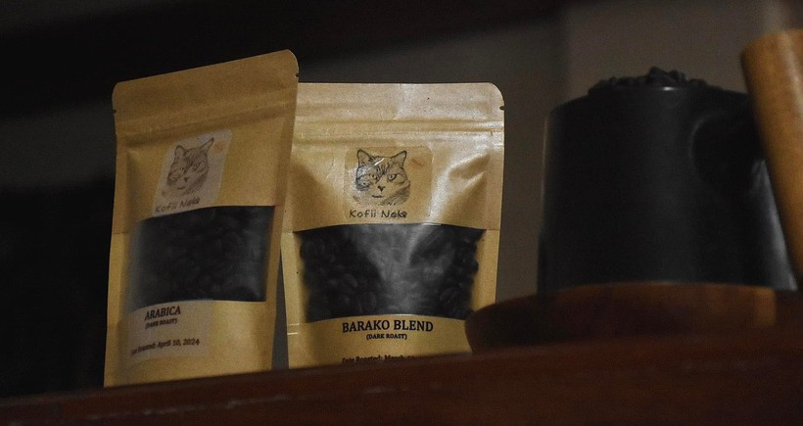
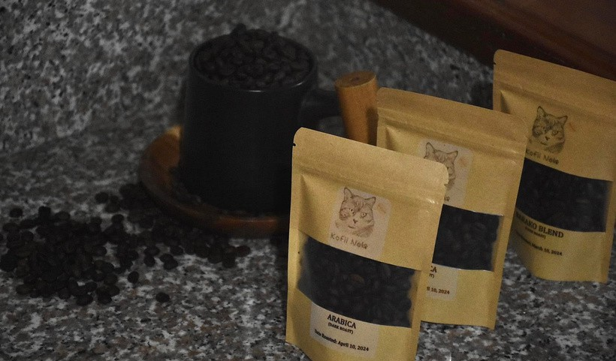
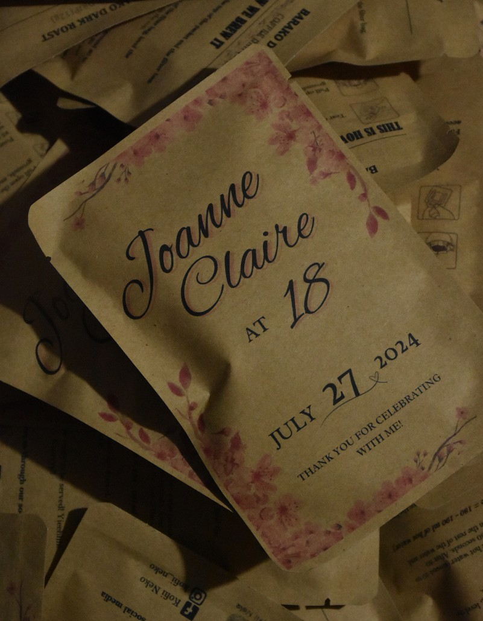
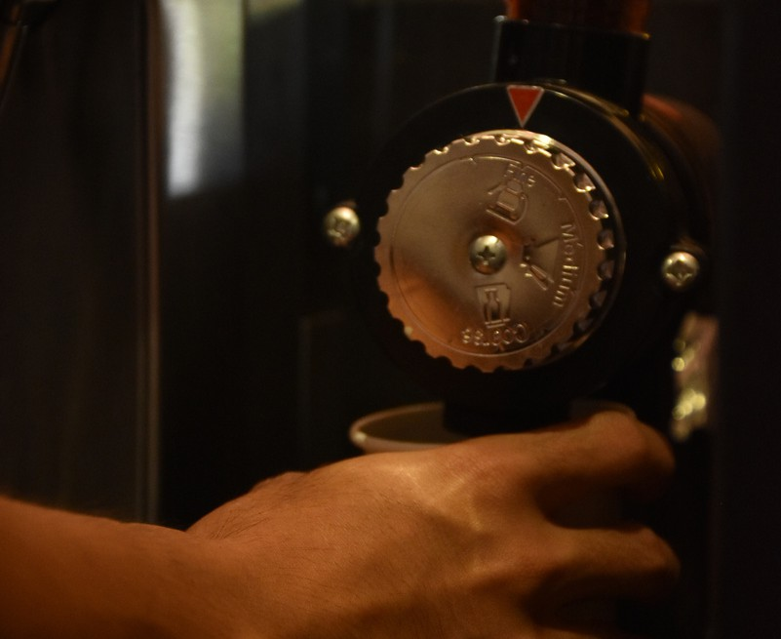
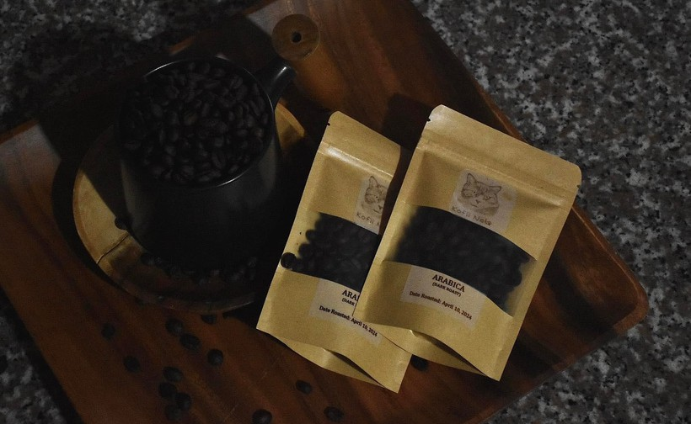
PHOTOGRAPHY

Slide 4
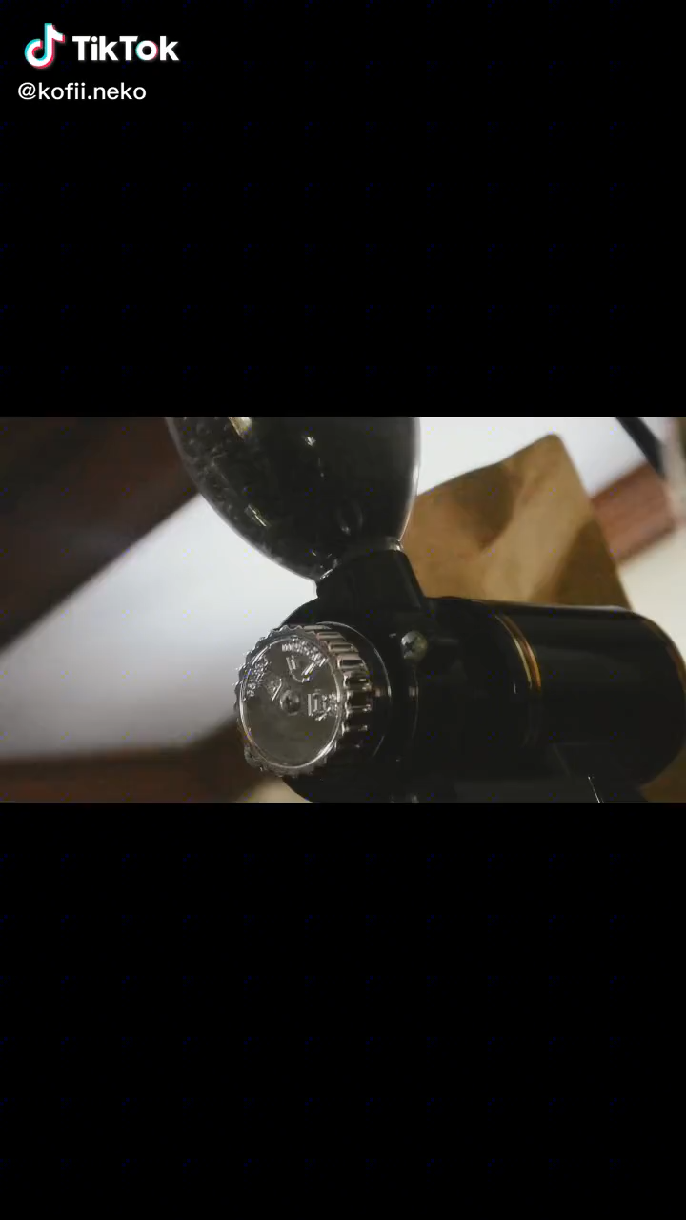

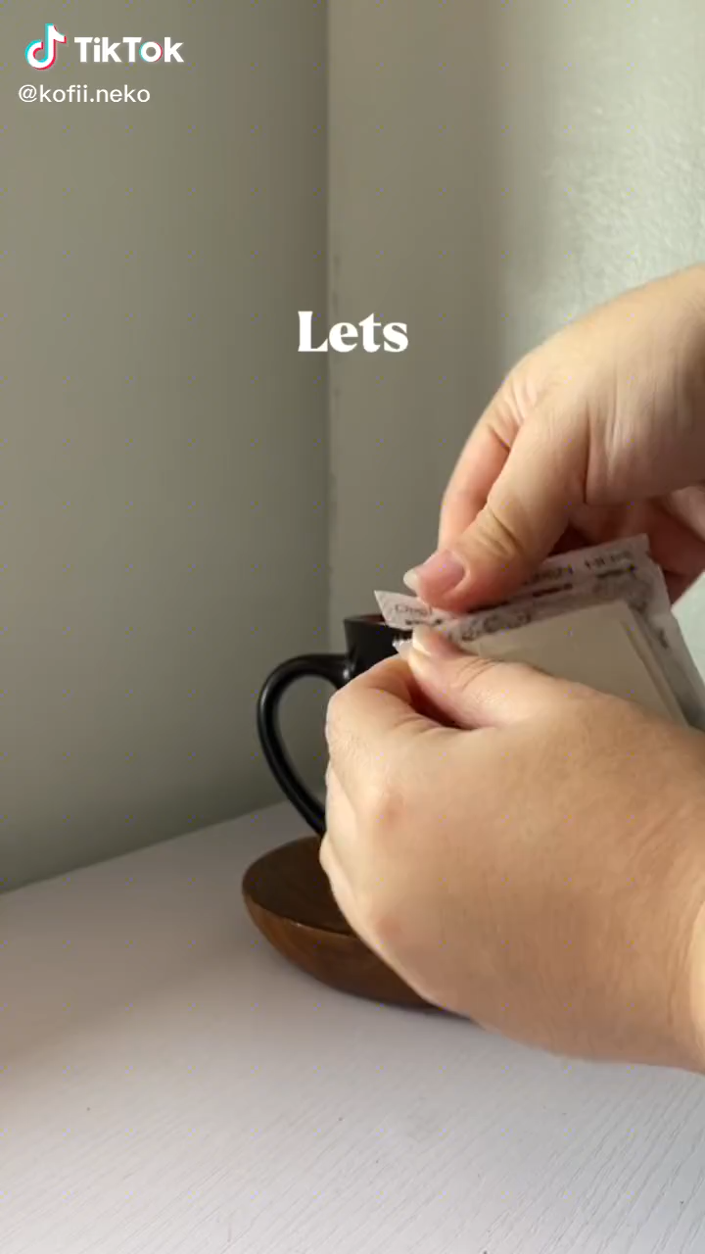
VIDEO EDITS

Slide 5
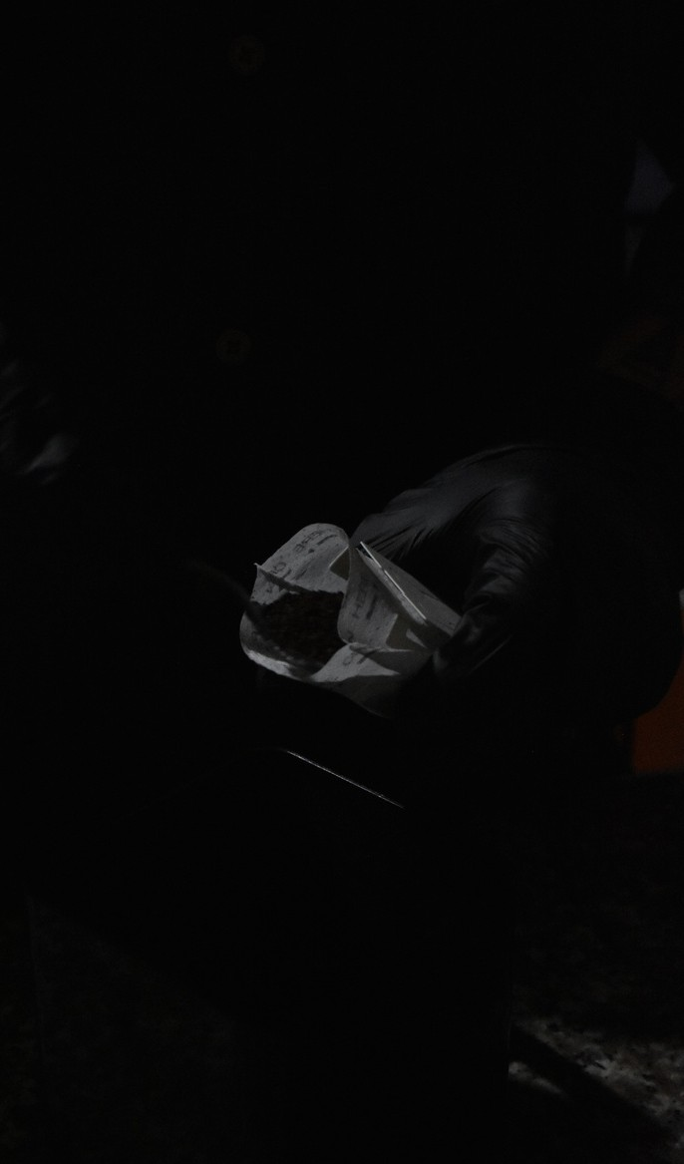
SERVICES OFFERED
Video Editing
Crafting engaging and polished video content tailored for various platforms.
Videography
Capturing high-quality footage with a focus on storytelling and visual appeal.
Product Photography
Showcasing products through clean, detailed, and brand-aligned images.
Social Media Management
Planning, creating, and managing content to boost online presence and audience engagement.

Slide 6
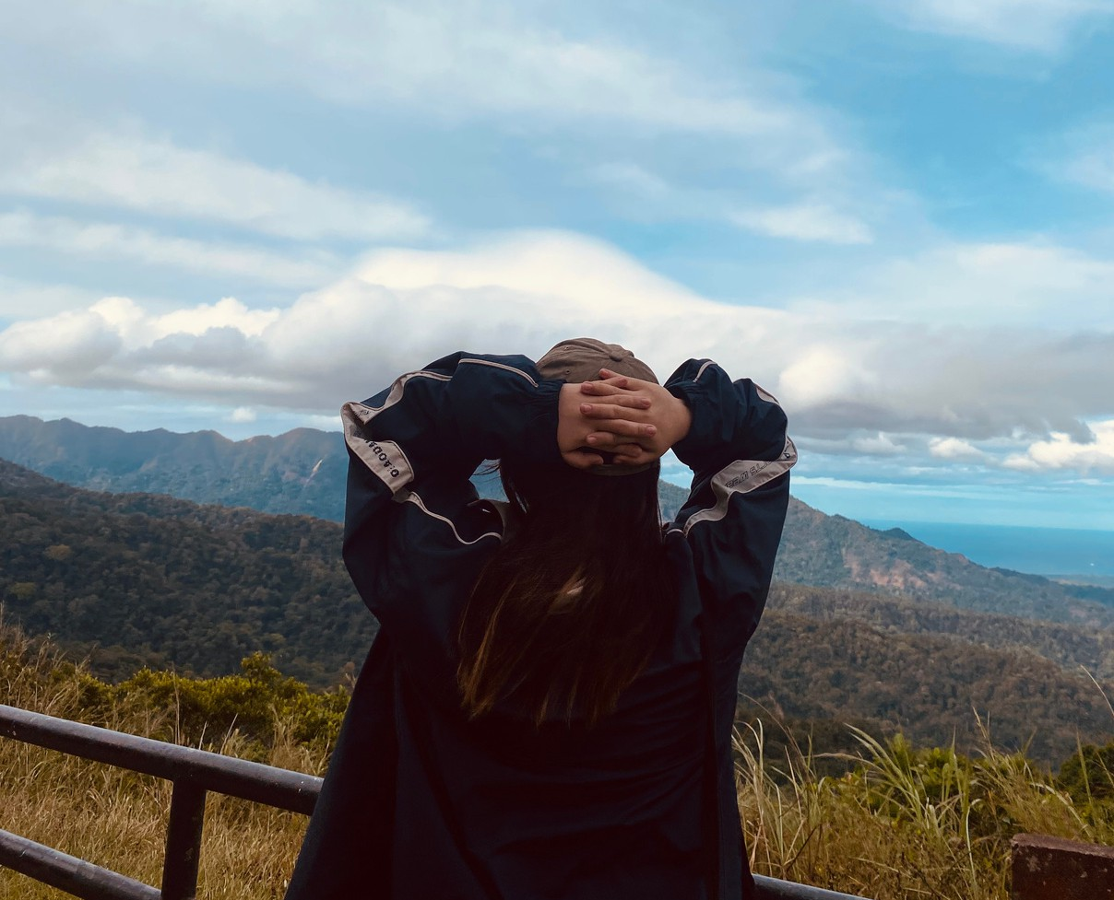

WORK WITH ME
PHONE
0975 521 8198
EMAIL
cassandradc176@gmail.com

